Slide 1

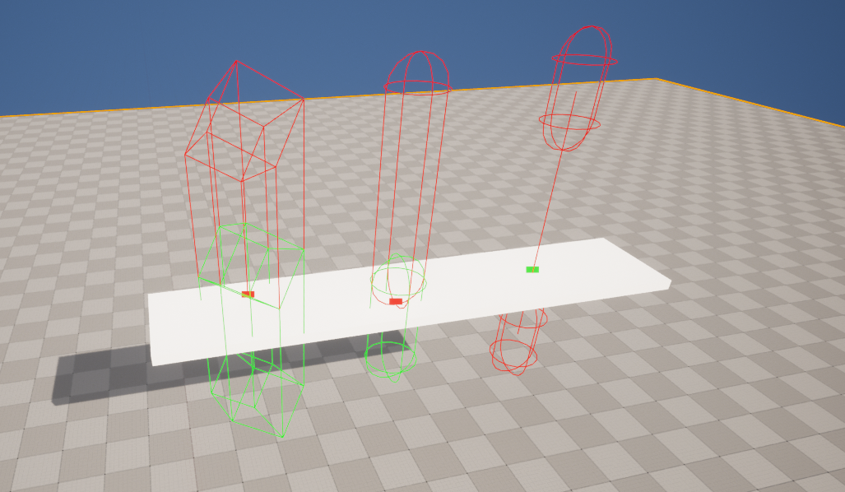
Traces

Slide 2
Traces
an invisible ray that detects Actors between two points
commonly used to determine if one Actor can see another Actor
also commonly used to simulate high-speed projectiles
single trace - returns the first match
multi trace - returns all matches
shape of the ray can be a line, box, sphere, or capsule
trace by channel, object, or profile

Slide 3
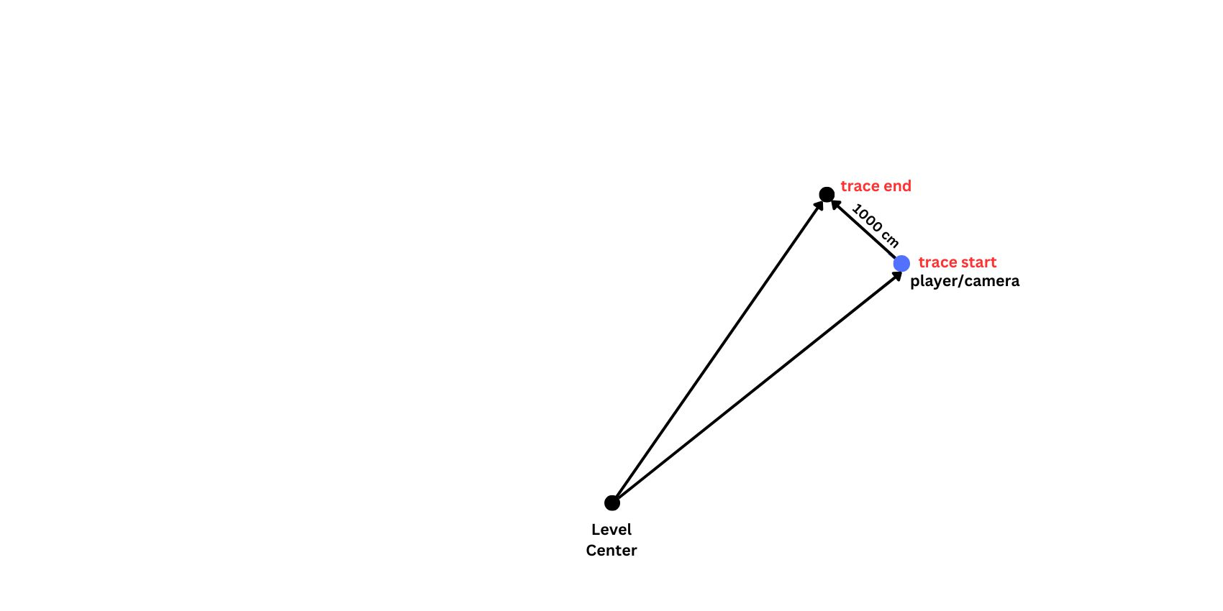
Traces

Slide 4

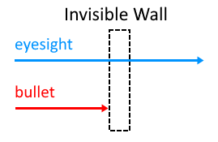
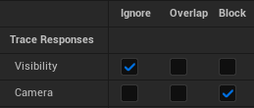
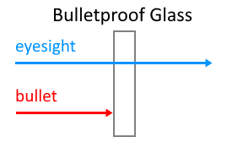
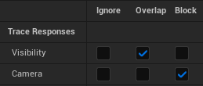
Traces

Slide 5
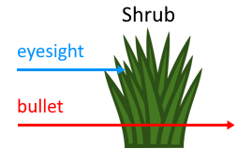
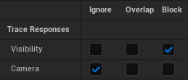
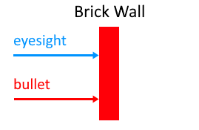
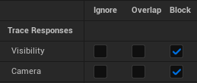
Traces

